Slide 1

Digital Aviation Azure
Service Capabilities Roadmap Nov 2016
v2.4 Nov 08, 2016

Slide 2
Paths to Create and Vet Service Capabilities
Managed Services Review - The DA Azure Common Core and Security team is actively vetting the technical capabilities and security competencies of Azure PaaS and SaaS service offerings.
Developed Services - The DA Azure Common Development team is vigorously creating services that add value to all users of DA Azure, from Application teams, to Developers, to Operation teams.
Application Review - An application team finding that they need a technical element that is not yet created or vetted may include this component in their architecture for security review.
All services and developed solutions undergo two security reviews –
Fit For Use (FFU) and Jeppesen Risk Assessment (JRA).
Once permitted, the service and developed solution will be included in the approved list for use.

Slide 3















































Managed Services – Oct 2016
18 - Complete
19 – Target 2Q/17
6 - Future
Compute
Web & Mobile
Data and Storage
Analytics
Network and CDN
Enterprise Integration, Identity & Access Management
Intelligence
Dev Services
Others
Management
Management
Dashboard
Security

Slide 4
Managed Services – 2Q/2017
35 - Complete
6 – Target 3Q/17
? - Future
Compute
Web & Mobile
Data and Storage
Analytics
Network and CDN
Enterprise Integration, Identity & Access Management
Intelligence
Dev Services
Others
Management
Management
Dashboard
Security

Slide 5
Developed Services – EOY 2016 and Future
Completed | Category
Network Security Perimeter | Security
Account Management | IAM
Key Management | Security
Internal Dev Stack | Developer Tools
IaaS Automation | Automation
In Progress – Target EOY 2016 | Category
Gitlab | Developer Tools
Jenkins | Developer Tools
Chef | Developer Tools
Artifactory | Developer Tools
NPM, GNUGet, Maven, Artifact | Repositories
Docker Registry (Supporting Swarm Kubernetes, Mesos & more) | Container Orchestration
Future – Target 2Q/17 | Category
Sonar Cube | Test Automation
Monitoring | Automation
Dashboard | Automation
Incident Management | Integration
Release Management | Integration
Chef: Supermarket | Developer Tools - Automation
Axway | MFT

Slide 6
Raw Service list – Includes sub-category areas
27 | Complete
25 | In-Progress
8 | Future Program Increment
8 | Far Future
11 | Low Priority
79 | Total Services Listed

Slide 8
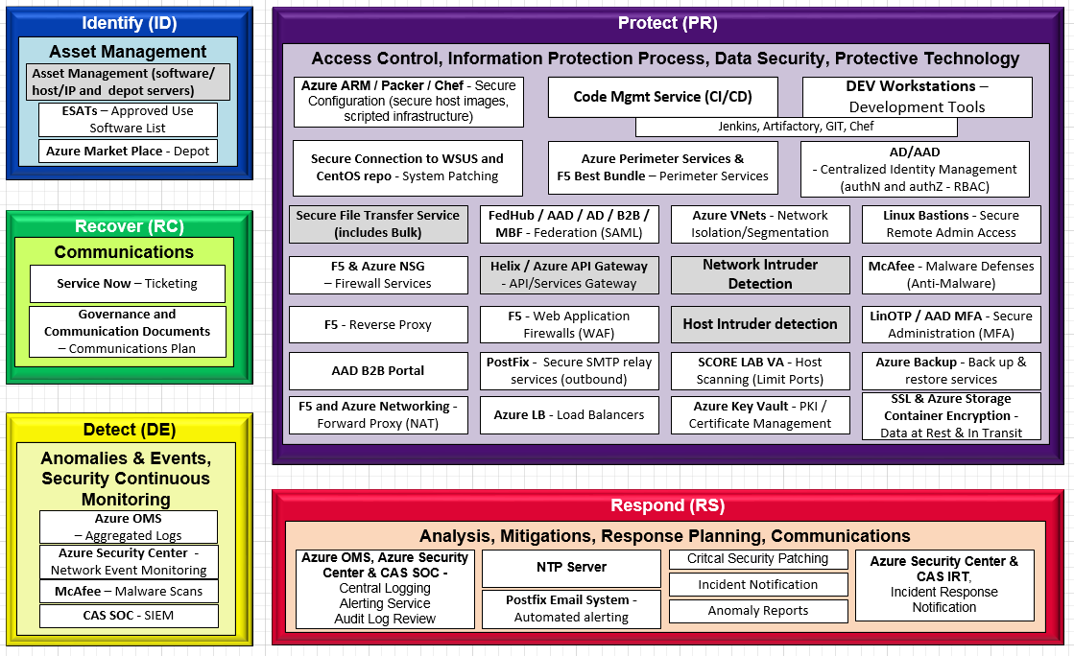

Slide 9


Icon Cache
http://azureplatform.azurewebsites.net/en-us/
Compute
Web & Mobile
Data and Storage
Analytics
Network and CDN
Enterprise Integration, Identity & Access Management
Intelligence
Dev Services
Others
Management
Management
Dashboard
Security

Slide 10







Icon Cache

